Slide 1
How does work piezo sensor – piezo sensor with Arduino UNO board.
Dr\Marwa Hamed

Slide 2
Introduction
In any system, we care about many things, including accuracy, efficiency, and speed in any industry as , and in this case we need something that measures changes and makes quality excellent and high accuracy, and the device that will do all this for us is the sensor. We will talk about it in detail now.

Slide 3
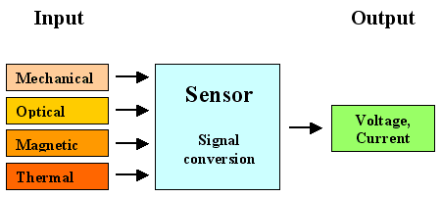
Sensor
A sensor is a device that produces an output signal for the purpose of sensing a physical phenomenon.
In the broadest definition, a sensor is a device, module, machine, or subsystem that detects events or changes in its environment and sends the information to other electronics, frequently a computer processor.

Slide 4
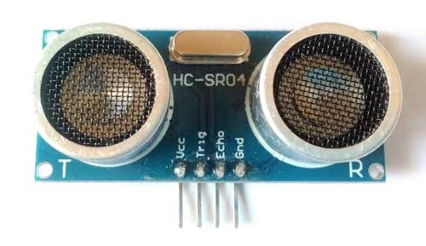
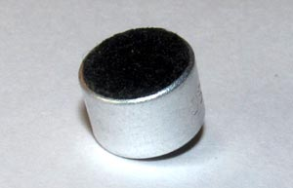
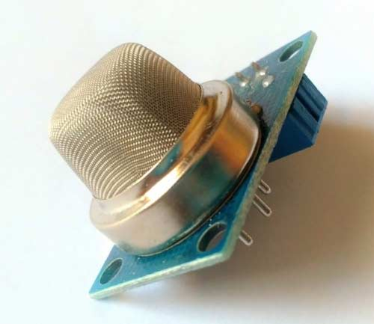
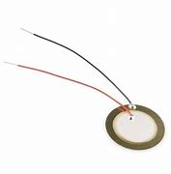
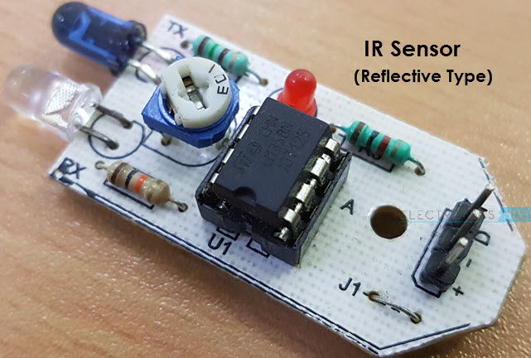
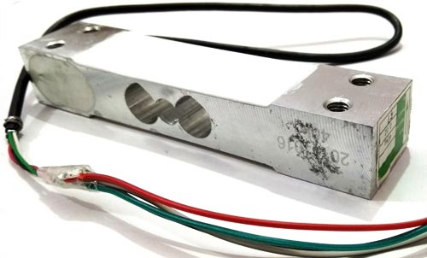
Different Types of Sensors
(a) Distance sensor
(b) Sound sensor
(c) Gas sensor
(d) Pressure Sensor
(e) IR sensor
(f) Weight sensor

Slide 5
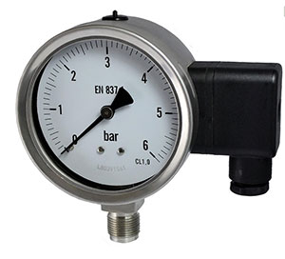

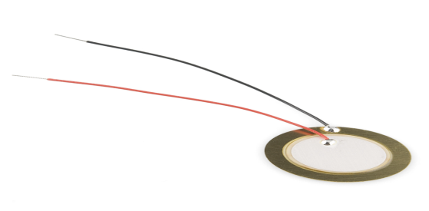
Pressure Sensor
A pressure sensor, as the name suggests, is a device that senses and measures pressure he pressure sensor in electronic circuits is in the form of an integrated circuit that acts as a transducer, that is, it replicates (in the form of an electrical signal) the signal it receives as a function of imposed pressure.
Pressure measurement technologies
(a) Potentiometric pressure sensors
(b) Capacitive pressure sensors
(c) Piezoelectric pressure sensors

Slide 6
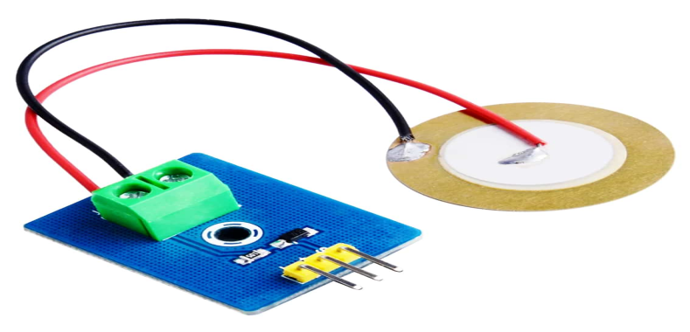
Piezoelectric sensors
A piezoelectric sensor, also known as a piezoelectric transducer, is a device that uses the piezoelectric effect to measure changes in pressure, acceleration, temperature, strain or force by converting these into an electrical charge.
(a) Piezoelectric sensor

Slide 7
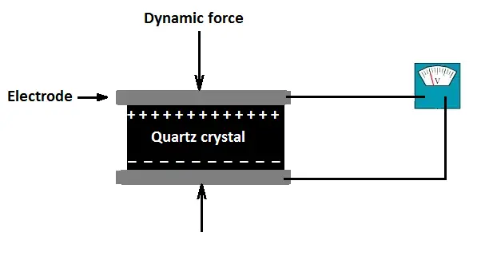
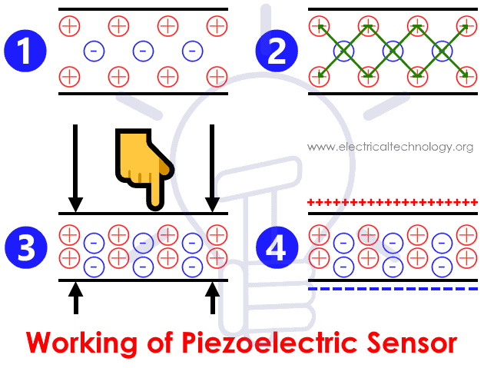
Working of Piezoelectric Sensor
When pressure or acceleration is applied to the PZT material, an equivalent amount of electrical charge gets generated across the crystal faces. Electrical charge will be proportional to the applied pressure. Piezoelectric sensor cannot be used to measure static pressure
This phenomenon is known as the piezoelectric effect and the material that exhibits this property is known as a piezoelectric material.
Steps involved in generation of Piezoelectricity

Slide 8
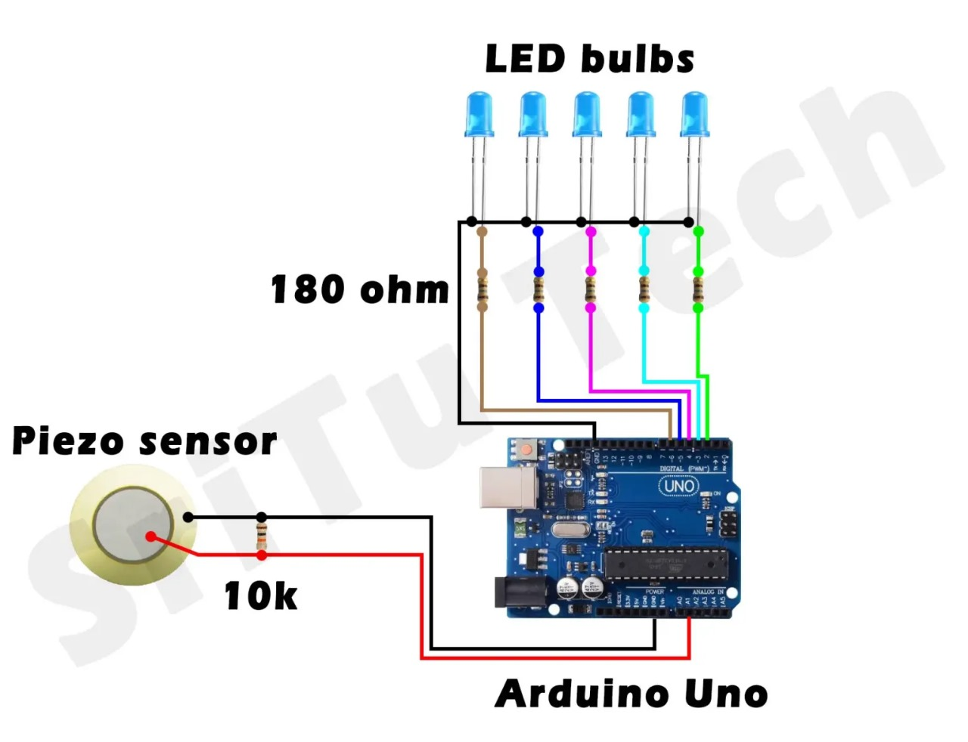
Circuit Diagram

Slide 9
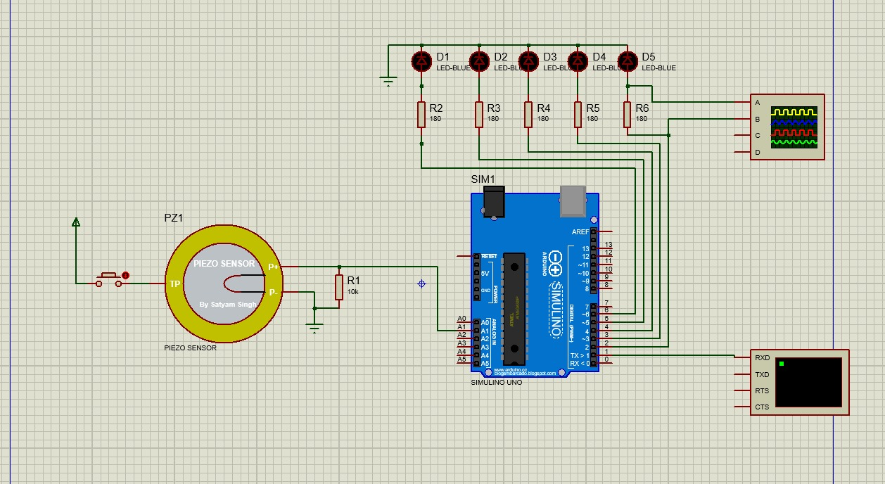
Simulation

Slide 10
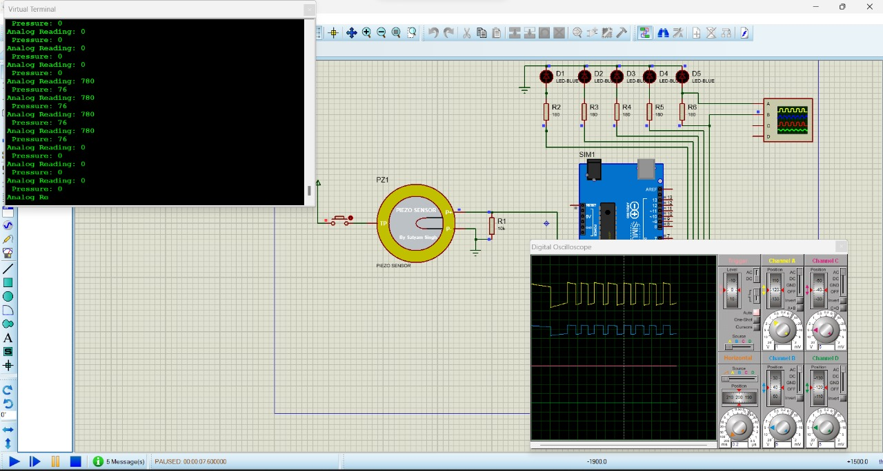
Simulation

Slide 11
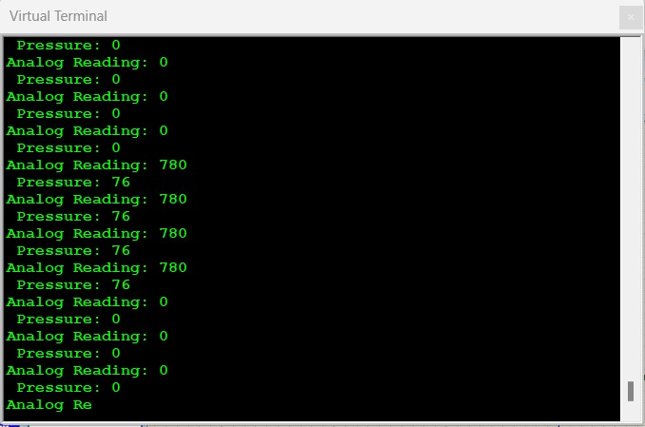
Simulation

Slide 12
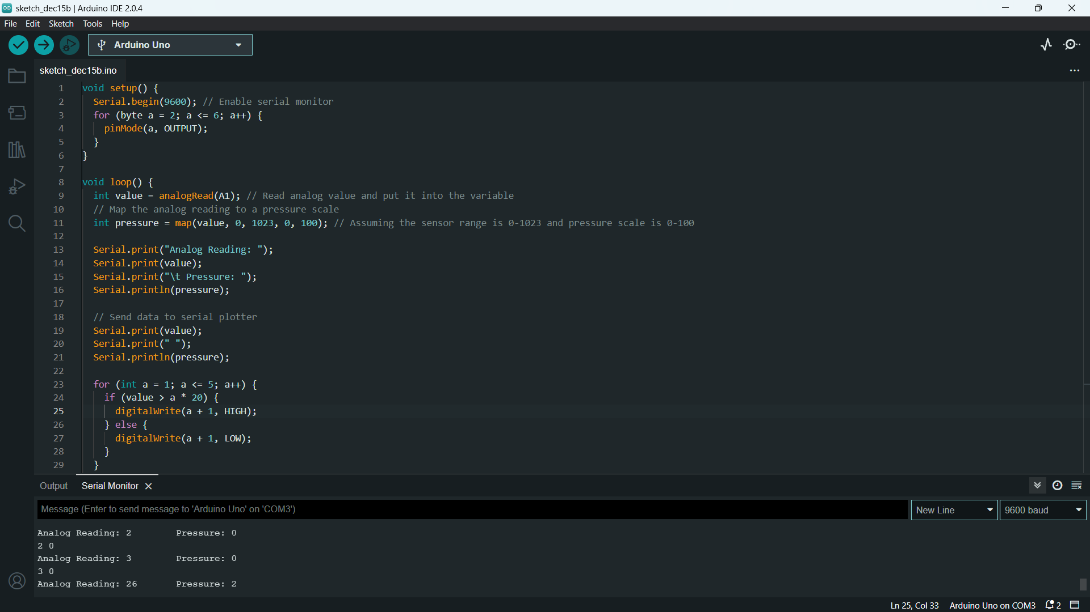
real

Slide 13
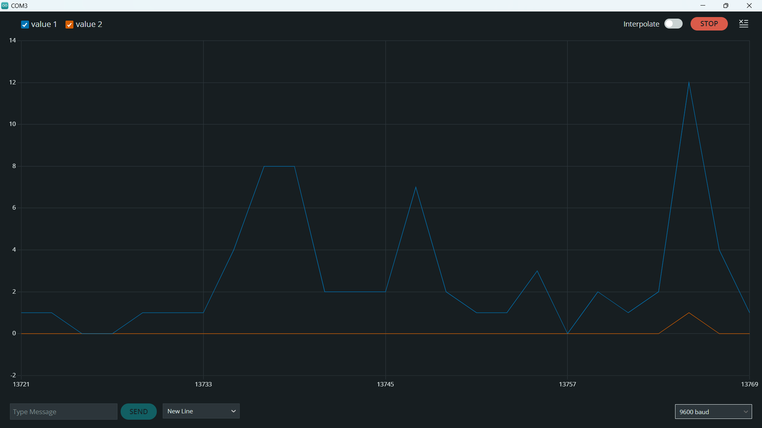
Real

Slide 14
How does work piezo sensor – piezo sensor with Arduino UNO board.

